Slide 1

UNIVERSAL ACCESS TO ELECTRICITY

Slide 2
Outline
Chapter 1. Introduction to electrification
Chapter 2. Energy resources assessment using GIS
Chapter 3. Electrification analysis using GIS
Chapter 4. ONSSET – An Open-Source Spatial Electrification Tool
Chapter 5. The online electrification interface
Chapter 6. Hands-on experience with ONSSET
Notes:
We will start with a brief introduction to the universal access to energy challenge and how we can deal with it using GIS energy planning tools. Then we will show how we are using GIS to assess the availability of energy resources and how to carry out electrification planning. Later on, we will introduce ONSSET, the Open-Source Spatial Electrification Tool.
Right after, the online electrification interface based on ONSSET will be presented. The session will close with a hands-on exercise.

Slide 3

4. ONSSET – OpeN-Source Spatial Electrification Tool
Specific objective: introduce an electrification tool
A KTH research initiative supported by:
Notes:
To carry out an electrification analysis, KTH Division of Energy Systems Analysis in collaboration with the United Nations Department of Economic and Social Affairs and other partners developed a transferable electrification tool called ONSSET.

Slide 4
About ONSSET
ONSETT is an open-source electrification tool and a bottom-up optimization model
It identifies the least-cost technological option for unserved areas
Extension of the national grid network
Mini-grid systems (hydro, PV, wind turbines, diesel gensets)
Standalone systems (PV, diesel gensets)
Aiming at ensuring full access to affordable, reliable, sustainable and modern electricity for all by 2030
Notes:
ONSSET is an open-source tool. This means that the code behind the tool, and its documentation and datasets are publicly available.
ONSSET is a bottom-up optimization tool, which means that it is a technology-driven model, the objective of which is to achieve full access to affordable, reliable, sustainable and modern electricity for all by 2030 for the lowest cost.
It compares a plethora of mature electrification technologies in order to come up with the lowest-cost one. The technologies are ones mentioned earlier: extension of the national grid network; mini-grid systems that consist of hydropower plants, solar PV, wind turbines or diesel gensets; and standalone systems with either solar PV or diesel gensets.

Slide 5
Some facts about ONSSET
Based on Python and ArcGIS
Developed in six steps
Country-specific electrification analyses (national to subnational level)
Customize inputs according to country-specific characteristics
Social indicators (population growth, urbanization level, different demand patterns, etc.)
Technical factors (transmission and distribution losses for the national grid, alternative technologies available, etc.)
Cost elements (investment cost, operations and maintenance, fuel, etc.)
Energy access targets
Notes:
Let’s see some facts with regards to ONSSET.
It is based on Python and ArcGIS (the most widely used GIS software).
It is developed in six simple dependent steps.
The analysis can be done on the subnational or national level, and the resolution varies from 1 kilometre to 10 kilometres.
There are several inputs that need to be customized while performing an analysis. These inputs include social indicators such as population growth, etc.; technical factors such as transmission losses, etc.; and different cost elements such as capital, etc.

Slide 6
ONSSET in six steps
Notes:
We have selected a country case study (Kenya) to delineate the six steps involved in the electrification analysis.

Slide 7
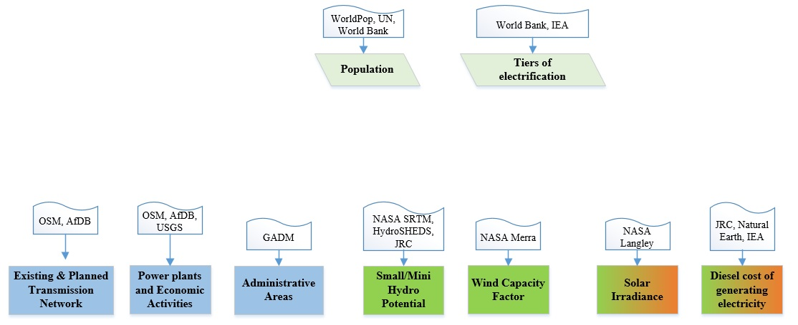
Step 1. Acquire the necessary GIS data for the area of interest
A GIS environment (ArcGIS, QGIS, GRASS) is required
The population density and distribution are publicly available at a global scale. Data from domestic statistical bureaus can be used if available.
What should be the electricity consumption level per household?
Information about the current grid infrastructure – where and what is available?
Information about resources availability – where and what is available?
Notes:
We start with the acquisition of data for the area of interest. To do so, we need GIS software, such as ArcGIS (proprietary) or QGIS and GRASS, which are open-source equivalents.
We need information related to the electricity demand. In our analysis, this is defined by population density and distribution, which are publicly available at global scale, and the level of electricity consumption per household. These data can be obtained either from domestic statistical bureaus or international sources such as the World Bank, United Nations Population Division or the International Energy Agency.
Further, we need infrastructure-related information. Where are the transmission lines, the power plants and the economic activities located? This information is obtained from sources like OpenStreetMap, the African Development Bank, the United States Geological Survey, the Global Administrative Areas spatial database, etc.
Lastly we need information related to available energy resources (e.g., from NASA).

Slide 8
Step 1. Acquire the necessary GIS data for the area of interest
# | Dataset | Type
1 | Population density and distribution | Raster
2 | Administrative boundaries | Raster
3 | Existing grid network | Line shapefile
4 | Substations | Point shapefile
5 | Power plants | Point shapefile
6 | Mines and quarries | Point shapefile
7 | Roads | Line shapefile
8 | Planned grid network | Line shapefile
# | Dataset | Type
9 | Nighttime lights | Raster
10 | Global horizontal irradiation | Raster
11 | Wind speed | Raster
12 | Hydropower potential | Point shapefile
13 | Travel time | Raster
14 | Elevation map | Raster
15 | Slope | Raster
16 | Land cover | Raster
GIS data requirements may vary depending on the objective of the electrification study

Slide 9
Step 1. Acquire the necessary GIS data for the area of interest
# | Dataset | Type | Purpose of use in the ONSSET analysis
1 | Population density and distribution | Raster | Spatial identification and quantification of the current (base year) population. This dataset sets the basis of the ONSSET analysis as it is directly connected with the electricity demand and the assignment of energy access goals.
2 | Administrative boundaries | Raster | Includes information (e.g., name) of the country(s) to be modelled and delineates the boundaries of the analysis.
3 | Existing grid network | Line shapefile | Used to identify and spatially calibrate the current population with/without electricity.
4 | Substations | Point shapefile | Current substation infrastructure used to identify and spatially calibrate the current population with/without electricity. It is also used to specify grid extension suitability.
5 | Power plants | Point shapefile | Current/future power plant infrastructure used to identify and spatially calibrate the current population with/without electricity. It is also used to specify grid extension suitability.
6 | Mines and quarries | Point shapefile | Mines are very important in electrification processes and are usually used to specify grid extension suitability.
7 | Roads | Line shapefile | Current road infrastructure used to identify and spatially calibrate the current population with/without electricity. It is also used to specify grid extension suitability.
8 | Planned grid network | Line shapefile | Represents the future plans for the extension of the national electric grid. It also includes extension to current/future substations, power plants, mines and quarries.
9 | Nighttime lights | Raster | Dataset used to identify and spatially calibrate the current population with/without electricity.
10 | Global horizontal irradiation | Raster | Provides information about the global horizontal irradiation (kWh/m²/year) over an area. This is later used to identify the availability/suitability of PV systems.
11 | Wind speed | Raster | Provides information about the wind velocity (m/sec) over an area. This is later used to identify the availability/suitability of wind power (using capacity factors).
12 | Hydropower potential | Point shapefile | Points showing potential mini/small hydropower potential. Dataset developed by KTH dESA including environmental, social and topological restrictions, and provides power availability in each identified point. Other sources can be used but should also provide such information to assure the proper model function.
13 | Travel time | Raster | Visualizes spatially the travel time required from any individual cell to the closest town with a population of more than 50,000 people.
14 | Elevation map | Raster | Filled DEM maps are use in a number of processes in the analysis (energy potentials, restriction zones, grid extension suitability map, etc.).
15 | Slope | Raster | A sub-product of DEM, used in forming restriction zones and to specify grid extension suitability.
16 | Land cover | Raster | Land cover maps are used in a number of processes in the analysis (energy potentials, restriction zones, grid extension suitability map, etc.).

Slide 10
Step 2. Use GIS techniques to extract useful information for the analysis
(the data are transferred to Excel)
Grid cell distance from the nearest town
Wind power availability in each grid cell
Grid cell coordinates
X | Y
2370166 | 228283
1907255 | -441856
2953836 | -904402
3155102 | -451877
2692191 | -833762
1655673 | -582265
Population (2010) | Country
0 | Kenya
388 | Kenya
2,136 | Kenya
2,139 | Kenya
280,088 | Kenya
543,581 | Kenya
Distance existing (m) | Distance planned (m)
243,796 | 228,416
44,357 | 44,357
141,565 | 112,059
73,645 | 73,645
133 | 133
1,514 | 403
Distance from roads (m)
11,107
9,712
4,690
20,098
5,839
451
Global horizontal irradiation (kWh/m2/year)
1822
1827
2006
1814
1912
1750
Travel hours (h)
1
3
4
15
2
0
Diesel current $/kWhel | Diesel future $/kWhel
0.12 | 0.26
0.14 | 0.29
0.14 | 0.29
0.23 | 0.51
0.13 | 0.28
0.11 | 0.24
Capacity factor (%)
0.0
3.2
10.1
2.2
0.0
0.0
Distance from existing and planned transmission network
LCoE of diesel gensets under current and projected diesel price
Notes:
Moving on to the second step, we are applying GIS techniques to extract useful information for all studied locations.
Initially, we get the coordinates of each location, and thereafter, we expand a table of useful attributes, shown in the previous slide.
The table includes population and administrative boundary information (in this case, country), the distance of each location to the existing and planned tranmission network,the distance to the road network, global horizontal irradiation, the travel time to the nearest major towns (used to calculate diesel transportation costs), and the wind power availability.

Slide 11
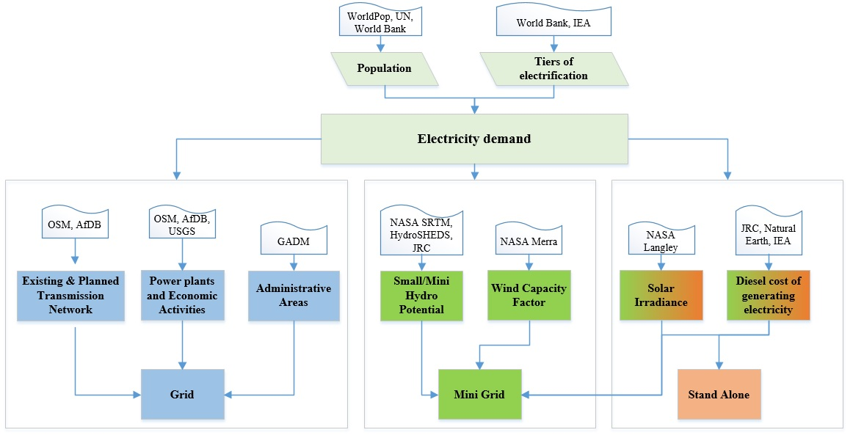
Step 3a. Enter country-specific data (social)
Population characteristics are important in the analysis and can be used to guide projection of the electricity demand
The targeted access level is also an important input in the analysis as it is used to quantify the future electricity demand
Notes:
As soon as we have collected resource-related information for a studied area, we need to add country-specific data. These data involve socioeconomic and demographic indicators, energy access targets and cost-related figures.

Slide 12
Step 3a. Enter country-specific data (social)
Parameter | Metric | Base year value | Value 2030
Population, total | Million persons | 42.542¹ | 65.412 (medium growth projection)¹
Urban population | Percentage of total population | 25%² | 32% (based on >2000 people/km^{2,6}
Rural population | Percentage of total population | 75%² | 68%
Urban growth | Percentage growth per year | 4.34%³ | 4% (assumed value, based on total population 2030)
Rural growth | Percentage growth per year | 2.14%³ | 2% (assumed value, based on total population 2030)
Electricity access | Percentage of total population | 23%⁴ | 100%⁷
Electricity access, urban | Percentage of urban population | 58.2%⁴ | 100%⁷
Electricity access, rural | Percentage of rural population | 6.8%⁴ | 100%⁷
People per household, urban | People per household | 5⁵ | 4⁸
People per household, rural | People per household | 6.5⁵ | 6.5⁸
United Nations Population Division, 2015
United Nations Population Division, 2013
United Nations Statistical Division, 2016
World Bank, 2016
Energy Regulatory Commission, 2011
Kenya National Bureau of Statistics, 2010
Based on SDG 7
Energy Regulatory Commission, 2011
Notes:
The acquired GIS information needs to match the reported national statistics values; thus, data calibration is necessary. Thereafter, data are projected to 2030 values. To illustrate, the projected population in Kenya in 2030 according to the United Nations Population Division reaches 65 million people. The sum of the projected population of all GIS cells should match this number.

Slide 13
Step 3b. Enter country-specific data (energy access target)
Scenarios | Average electricity consumption (2030) | Rural electricity consumption | Urban electricity consumption
Low electricity consumption | ~1,000 kWh/household | 224 kWh/household | 1,800 kWh/household
Medium electricity consumption | ~1,500 kWh/household | 696 kWh/household | 2,195 kWh/household
High electricity consumption | ~2,195 kWh/household | 2,195 kWh/household | 2,195 kWh/household
Notes:
National documents and plans for the power sector can provide country-specific electricity consumption levels.

Slide 14
Step 3c. Enter country-specific data (preparation – calibration)
1: Settlement electrified by grid
0: Settlement not electrified
X | Y
2370166 | 228283
1907255 | -441856
2953836 | -904402
3155102 | -451877
2692191 | -833762
1655673 | -582265
Population (base year) | Country
0 | Kenya
388 | Kenya
2,136 | Kenya
2,139 | Kenya
280,088 | Kenya
543,581 | Kenya
Status | Population 2030
Rural | 0
Rural | 350
Urban | 2,500
Rural | 1,980
Urban | 295,980
Urban | 620,644
Distance from roads (m)
11,107
9,712
4,690
20,098
5,839
451
Nighttime lights
1
7
42
5
64
67
Electrification status
0
0
1
0
1
1
Diesel current $/kWhel | Diesel future $/kWhel
0.12 | 0.26
0.14 | 0.29
0.14 | 0.29
0.23 | 0.51
0.13 | 0.28
0.11 | 0.24
Capacity factor (%)
0.0
3.2
10.1
2.2
0.0
0.0
Change in social structures with urbanization – decreasing population in rural areas
Notes:
An important step is the identification of the current population with electricity on a spatial basis. Several datasets are used to calibrate a spatial electrification model, including nighttime lights, tranmission networks as well as road networks.

Slide 15
Step 3d. Enter country-specific data (technology specifications and costs)
Notes:
The next step of the analysis entails collecting country-specific data related to cost elements, since these are important determinants of electrification planning.

Slide 16
Step 3d. Enter country-specific data (technology specifications and costs)
Parameter | Capital cost $/kW | Operations and maintenance $/kW | Fuel cost $/MWh
PV | 2,566 ¹ | 389 (1.5% of capital cost)¹ | -
Wind | 2,500 ² | 50 (assumed 2% of capital cost) | -
Diesel generator, standalone | 938 ³ | 93 (assumed 10% of capital cost) | 173^{4,5}
Diesel generator mini-grid | 721 ³ | 72 (assumed 10% of capital cost) | 173^{4,5}
Mini/small hydro | 3 190 ³ | 64 (2% of capital cost) | -
Grid LCOE | 0.125 $/kWh
Adapted from Ondraczek, 2014
Adapted from IRENA, 2012
Adapted from ESMAP, World Bank
Adapted from Kenya, Ministry of Energy, 2010
Adapted from United States, Energy Information Administration, 2016
Adapted from Energy Regulatory Commission, 2013
Parameter | Capital cost $/km
High-voltage lines (>33kV) | 92,823⁶
Medium-voltage lines (33 kV) | 43,687³
Low-voltage lines (220 V) | 5,000³
High/low voltage transformer | 5,000 $ per unit³
Transmission loses | 18%
Connection cost per HH | $125
Notes:
National documents and plans for the power sector provide country-specific cost figures. If such data are not available, well-referenced generic values can be obtained from reliable international sources such as the International Renewable Energy Agency (IRENA), the Energy Sector Management Assistance Program (ESMAP), the International Energy Agency and the Energy Information Administration.

Slide 17
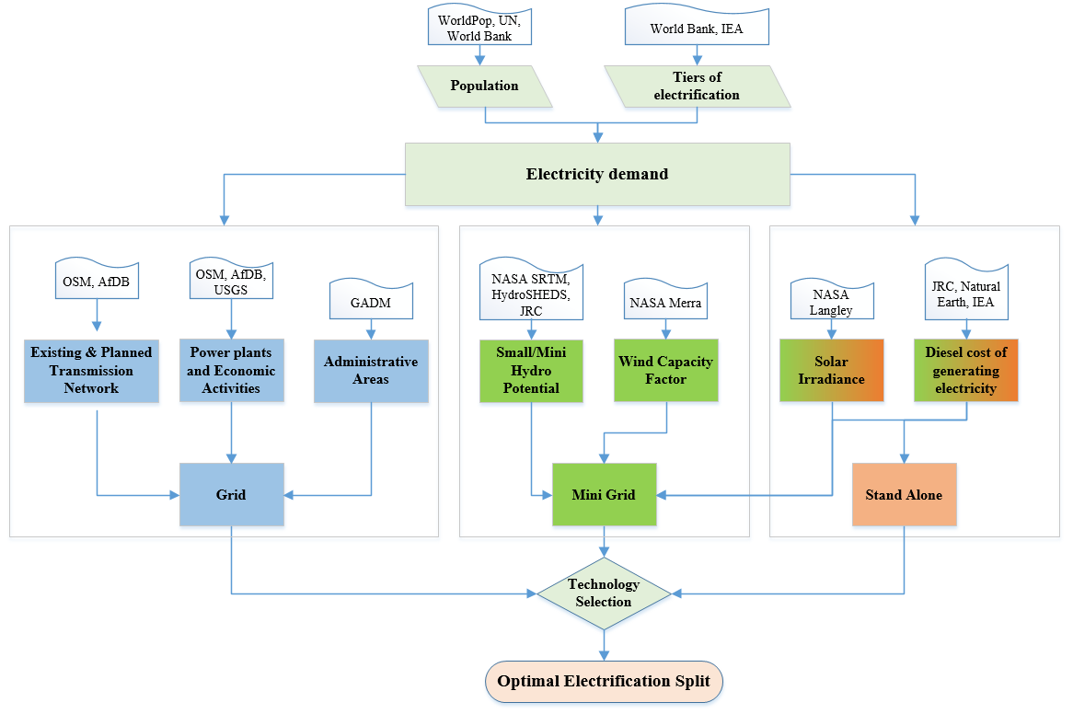
Step 4. Calculate technology costs for every settlement in the country
LCOEs achieved per technology per settlement
Settlements (people) | MG hydro | MG PV | SA PV | MG diesel | SA diesel | MG wind
11000 | 99.00 | 0.16 | 0.33 | 27.49 | 0.40 | 99.00
500 | 99.00 | 99.00 | 0.34 | 33.87 | 0.39 | 99.00
1300 | 99.00 | 99.00 | 0.33 | 12.12 | 0.31 | 99.00
23000 | 99.00 | 0.22 | 0.35 | 22.25 | 0.42 | 99.00
25000 | 0.16 | 21.53 | 0.34 | 22.94 | 0.46 | 99.00
680 | 99.00 | 99.00 | 0.35 | 27.23 | 0.47 | 99.00
15000 | 99.00 | 46.68 | 0.34 | 50.02 | 0.67 | 0.13
99 → Not available
Notes:
In this step, the costs for all different electrification technologies are calculated for all settlements.

Slide 18
Step 4. Calculate technology costs for every settlement in the country
Here is an example of how the different technologies perform under certain assumptions:
- Energy access target: 1,000 kWh/hh/year
- Distance from the national electricity grid: 20 km
- Global horizontal irradiation: 1,500 kWh/m2/year
- Hydro availability: Positive
- Wind capacity factor: 40%
- Diesel price: 0.345 $/liter
Standalone system LCOEs change at later stages according to transportation costs
LCOE tables
Example of LCOE variation per technology depending on number of people per settlement
Population
1,000
2,000
10,000
50,000
Grid | Mini-grid wind
0.55 | 0.26
0.41 | 0.23
0.26 | 0.18
0.21 | 0.16
Mini-grid hydro
0.30
0.26
0.18
0.16
Mini-grid PV
0.34
0.31
0.26
0.24
Mini-grid diesel
0.81
0.72
0.68
0.65
Standalone PV | Standalone diesel
0.36 | 0.18
0.36 | 0.18
0.36 | 0.18
0.36 | 0.18
Grid LCOE reduces in areas with high population density and proximity to the national grid
Mini-grid LCOEs usually depend on resource availability and fuel costs
Notes:
Based on the characteristics of each location, the model calculates the LCOE for each technology for various demand levels.

Slide 19
Step 5. The electrification algorithm – grid extension or off-grid?
?
50 km
?
Electrified
cells
1. Is the total additional medium voltage line less than 50 kilometres?
2. Are there enough people (thus demand) to justify an extension of the grid?
Notes:
A decision algorithm is ready to run as soon as we have obtained all the necessary data. Based on the characteristics of each location, the algorithm decides whether a grid extension is the most viable solution to provide electricity to unserved populations or an off-grid solution would be preferable. New connections per technology are identified as well as the required additional capacity and investments to reach full access to electricity.

Slide 20
Step 6. Results, summaries and visualization
Based on the optimal split, identify per technology:
New connections by 2030
Additional capacity needed
Investment requirements
Notes:
In this step, all different electrification technologies are compared (seven in number). The model decides the least-cost one for each location. New connections per technology are identified as well as the required additional capacity and investments to reach full access to electricity.

Slide 21
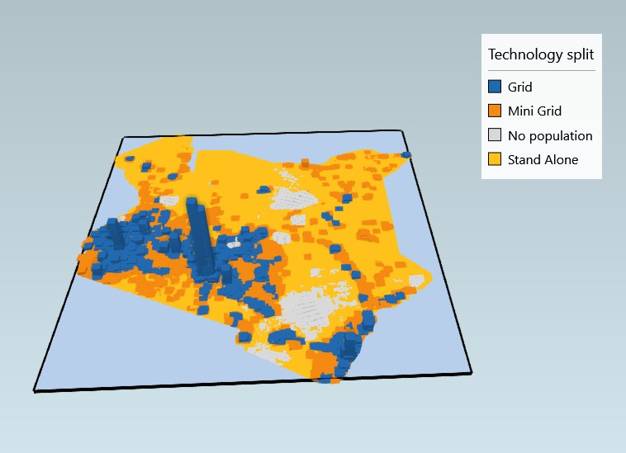
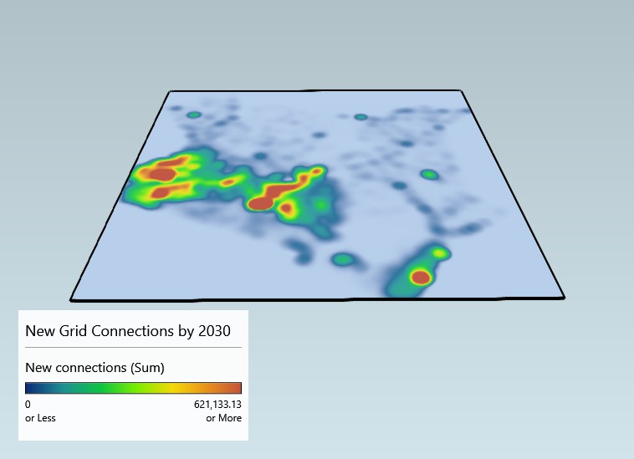
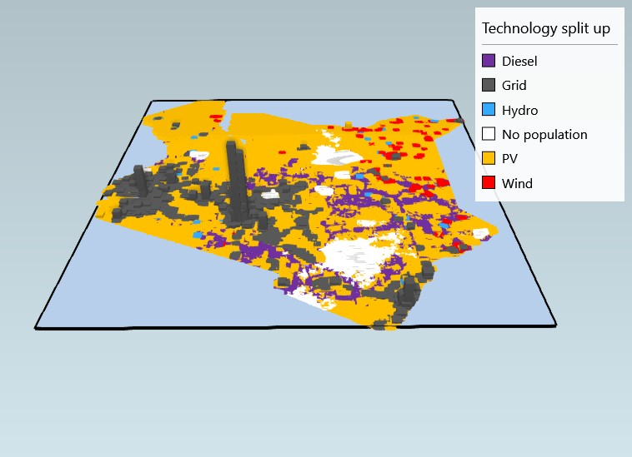
Results visualization
Household demand versus technology split under high-consumption scenario
New grid connections – high-consumption scenario
Household demand versus technology split under high-consumption scenario
Notes:
The last and very important step of the electrification analysis is the visualization of the results. These should be represented in an easy-to-grasp and informative way. There are different tools to visualize the results. One can use an extension of Microsoft Excel called Power Map, 3D maps or GIS software.
We will look at an easy way to create maps in Excel Power Map for quick visualization.

Slide 22
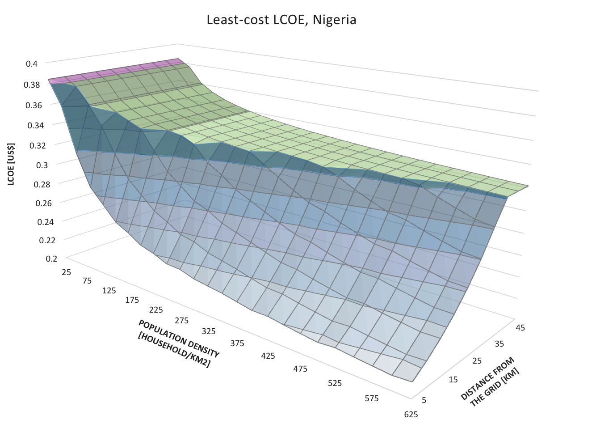
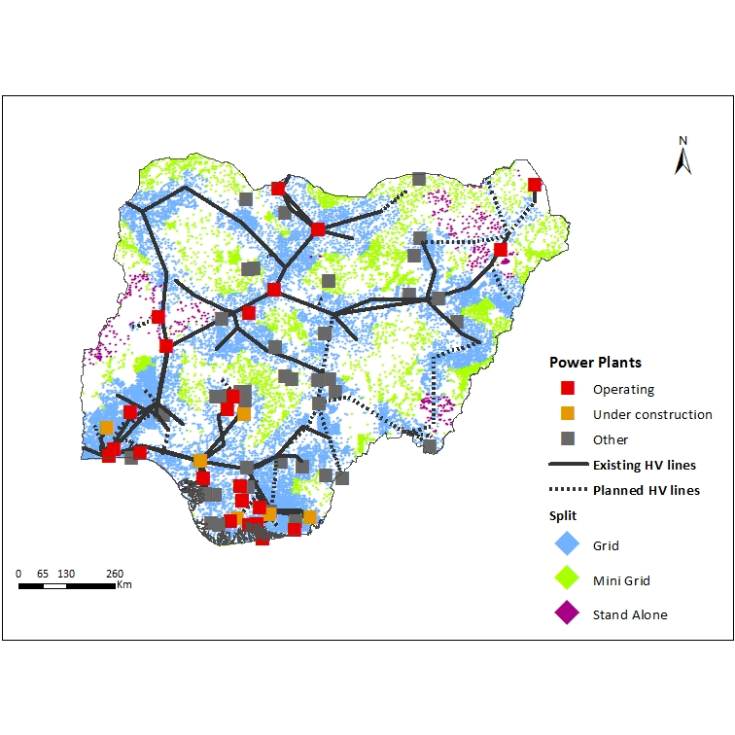
ONSSET results – the case study of Nigeria
Least cost LCOEs in Nigeria as a function of the distance to the grid and population density
Nigeria, least-cost split among grid, mini-grid and standalone electrification technologies
Notes:
The left side represents the country-specific surface of least-cost electrification options for Nigeria as a function of population density and settlement distance from the transmission grid. A green colour represents mini-grids, purple indicates standalone systems and light blue shows grid connections. For high population density close to the grid, the favourable solution is connection to the main grid.
As the distance from the grid increases, we get more mini-grid solutions in the system. In remote areas with low population density, standalone systems penetrate. This surface is applied throughout the entire country and shown graphically in the map on the right hand side. While a map representation is essential for communicating results in an easily absorbed manner, detailed information is missing. Results should be summarized in tables.

Slide 23
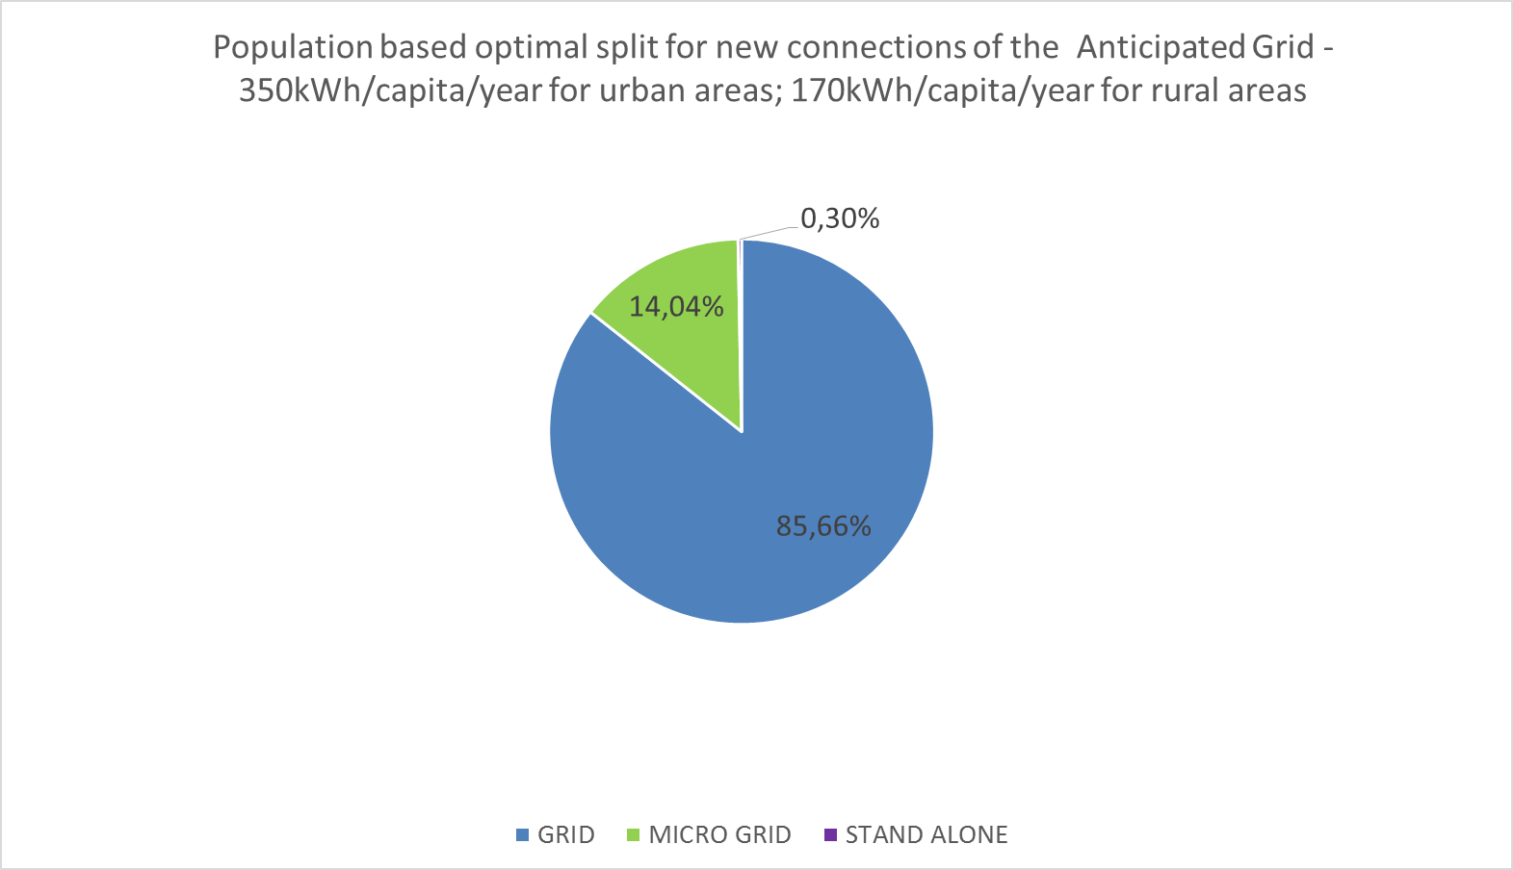
ONSSET results – the case study of Nigeria
Item | Related physical unit | Unit
Rural demand target | 170 | kWh/capita/year
Urban demand target | 350 | kWh/capita/year
Grid connections | 1,549 | Settlements
Grid connections | 33,727,783 | Households
Grid connections | 168,638,916 | People
Planned grid expansion (transmission with high-voltage lines) | 4,334 | km
Grid extensions for those gaining access (transmission with medium-voltage lines) | 78,295 | km
Grid extensions for those gaining access (distribution with medium- and low-voltage lines) | 1,084,544 | km
Mini-grid systems | 5,475 | Settlements
Mini-grid systems | 2,433,871 | Households
Mini-grid systems | 12,169,354 | People
Mini-grid generating capacity | 0.9 | GW
Mini-grid electricity generation | 2.1 | TWh
Standalone systems | 539 | Settlements
Standalone systems | 51,636 | Households
Standalone systems | 258,180 | People
Standalone systems generating capacity | 0.015 | GW
Standalone systems electricity generation | 0.044 | TWh
Notes:
This table presents the penetration of the main electrification technologies in terms of new connections, power capacity and electricity generation. For about 85 per cent of the newly electrified population, the connection to the main grid constitutes the most economical solution. Mini-grids and standalone systems with a 15 per cent share of new connections also play an important role in providing access to electricity in rural and remote areas

Slide 24
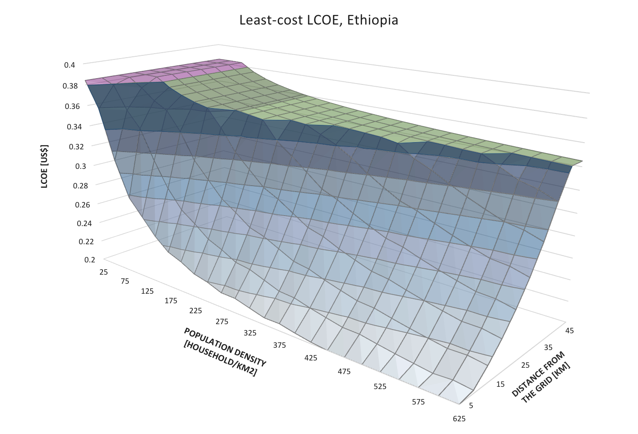
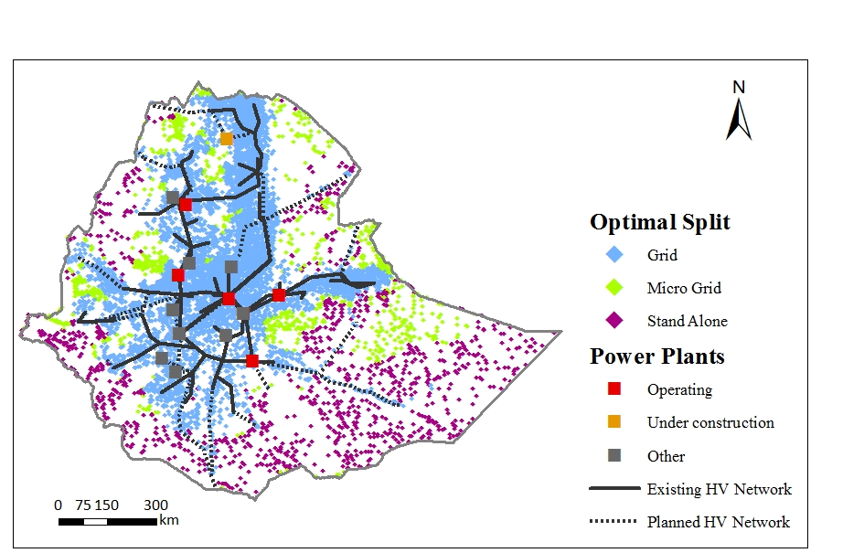
ONSSET results – the case study of Ethiopia
Least-cost LCOEs in Ethiopia as a function of the distance to the grid and population density
Ethiopia, least-cost split among grid, mini-grid and standalone electrification technologies
52
Notes:
Similarly for Ethiopia, a significant proportion of the population lives in areas that can be best connected through the grid reaching around 93 per cent of the new connections. But the overall population density of Ethiopia is considerably lower – the number of people per square kilometre (97) is half that of Nigeria (195) in 2014 (World Bank, 2016). This means that mini-grid and standalone options play a prominent role in remote areas depicted in green and purple, respectively.

Slide 25
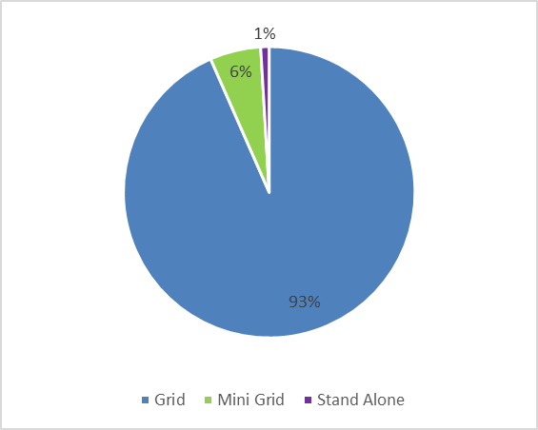
ONSSET results – the case study of Ethiopia
Item | Related physical unit | Unit
Rural demand target | 150 | kWh/capita/year
Urban demand target | 300 | kWh/capita/year
Grid connections | 7,844 | Settlements
Grid connections | 25,424,842 | Households
Grid distribution | 127,124,209 | People
Planned grid expansion (transmission with high-voltage lines) | 5,431 | km
Grid extensions for those gaining access (transmission with medium-voltage lines) | 36,343 | km
Grid extensions for those gaining access (distribution with medium- and low-voltage lines) | 513,407 | km
Mini-grid systems | 915 | Settlements
Mini-grid systems | 791,739 | Households
Mini-grid systems | 3,958,695 | People
Mini-grid generating capacity | 0.34 | GW
Mini-grid electricity generation | 0.84 | TWh
Standalone systems | 1060 | Settlements
Standalone systems | 131,353 | Households
Standalone systems | 656,767 | People
Standalone systems generating capacity | 0.032 | GW
Standalone systems electricity generation | 0.086 | TWh
Notes:
The results for Ethiopia are summarized in this table and graph. Approximately 127 million people would gain access through roughly 5,500 kilometres of high voltage grid extensions. For about 4 million people, mini-grid systems would be the favourable solution, while just over 650,000 people would connect to standalone systems.

Slide 26
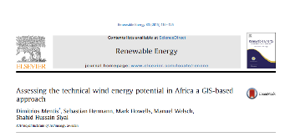



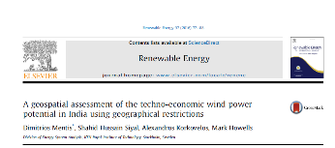
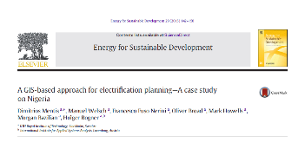


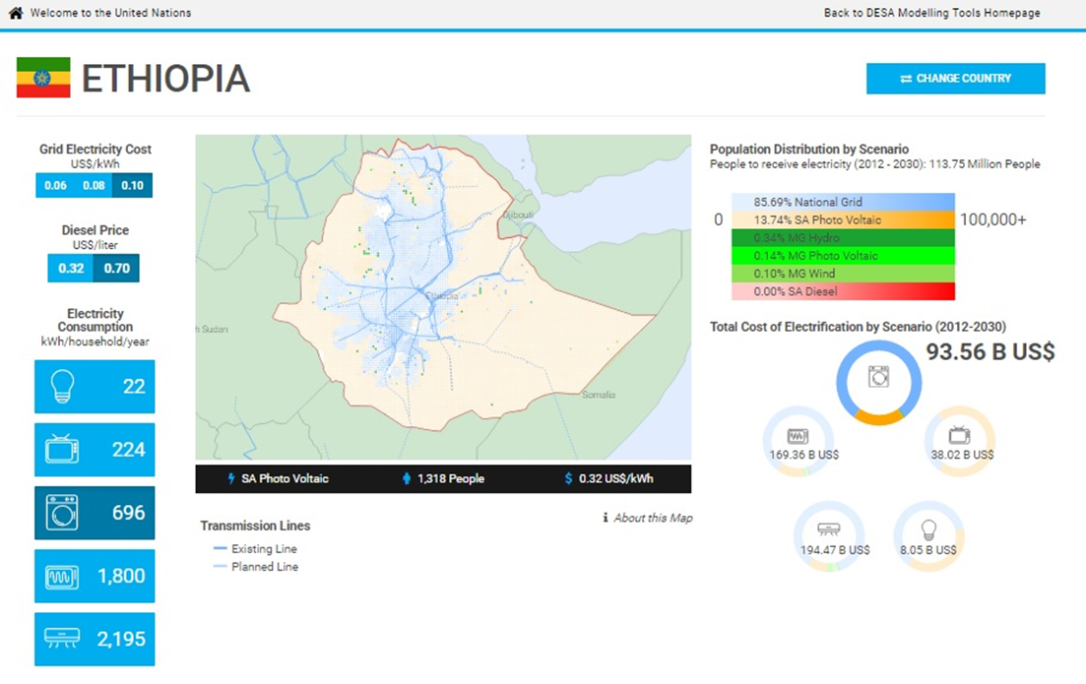

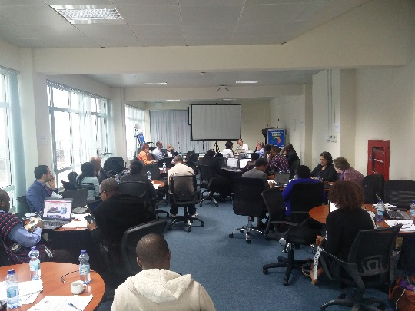
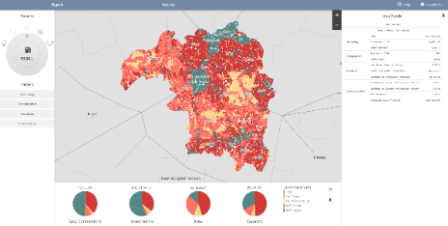

ONSSET contributions
International reports
Peer reviewed publications
Open-source platforms and applications
Capacity-building activities
Introduction to Modelling tools for Sustainable Development at UNDP, Addis, Ethiopia, August, 2016
Notes:
ONSSET aims at making a significant contribution to electrification planning approaches and energy resource assessments using GIS. A number of channels have been used to disseminate knowledge.
ONSSET is relatively young (two years old) but it has already featured in several high-impact peer reviewed journals. It has appeared in the World Energy Outlook (2014 and 2015) of the International Energy Agency, the Status of Energy Access Report (2016) of the World Bank, and the Global Tracking Framework (2015) of the International Energy Agency and the World Bank.
Furthermore, it features as the main tool for estimating the investments needs to achieve universal access in the United Nations Department of Economic and Social Affairs Modelling Tools for Sustainable Development.
Likewise, ONSSET has been used to develop a web-based open source application for national high-resolution, least-cost plans for universal access to electricity in Nigeria, the United Republic of Tanzania and Zambia, in collaboration with the World Bank and ESMAP. The developed application makes available the underlying datasets used to carry out electrification planning, such as demographic, resource and infrastructure data.
Finally, the toolkit is used to support capacity-building activities. Several analysts from the Ethiopian Ministry of Water, Irrigation and Energy were trained at KTH on how to use ONSSET. Similarly, we are using ONSSET to carry out a detailed electricity planning analysis for Afghanistan in collaboration with local authorities and experts as well as the World Bank.

Slide 27
5. The online electrification Interface
Specific objective: recognize the main features of the online electrification interface to perform an electrification analysis
Notes:
High interest from academia, international organizations and industry has driven the development of an open online interface that can be used by anyone in the world with access to the Internet. It provides insights related to electrification planning in developing countries.

Slide 28

The online electrification interface
In February 2016, the United Nations Department of Economic and Social Affairs in collaboration with KTH-dESA launched a regional investment outlook that will allow 44 African countries to achieve universal access to electricity.
http://un-desa-modelling.github.io/electrification-paths-presentation/
Notes:
This online interface is part of the modelling tools for sustainable development. It is not a model, but provides easy access to the methodology behind ONSSET, the datasets used, and the results obtained for a set of predefined scenarios and model runs. The development of the interface involved model runs in powerful computers. Initially, Africa was divided in squares of 10 x 10 kilometres. This gives approximately 240,000 cells. For all these cells, we determined the least-cost technology to reach full access to electricity, along with other critical figures in the next slides.

Slide 29

The online electrification Interface
An open and freely available source of information
Explore the model by selecting a country
Review the methodology
Notes:
The landing slide of the online interface introduces us to the universal access to electricity challenge. One can either explore the model or review the methodology, which was delineated earlier (see ONSSET). If we click on ”Explore the model”, we are directed to a map of Africa with 44 countries that face the challenge of providing electricity to unserved populations.

Slide 30
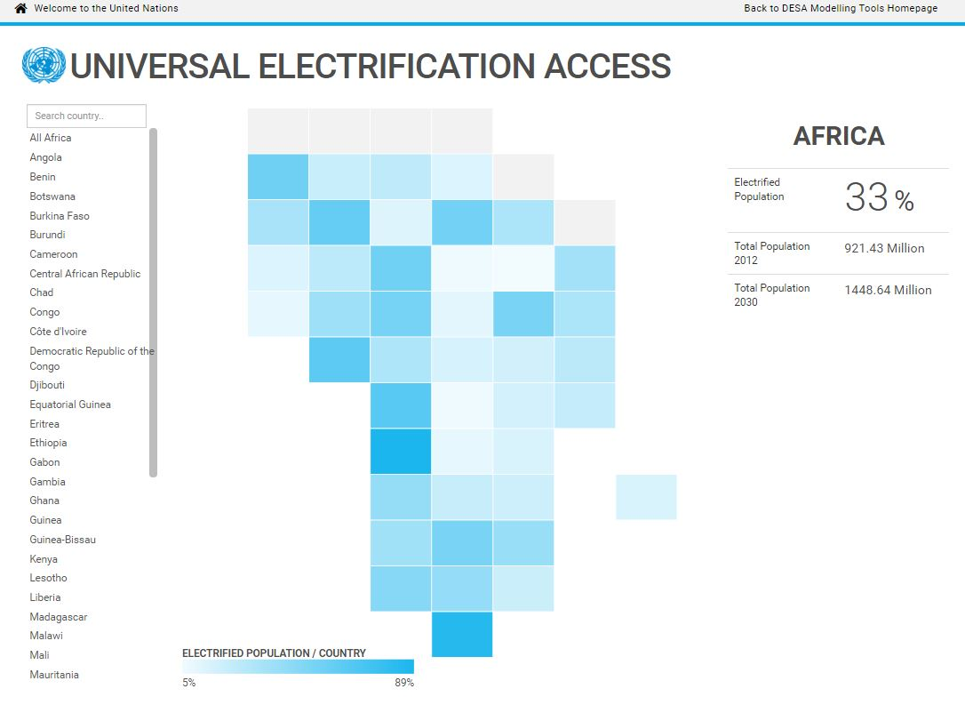
The online electrification interface
Current electrification status in sub-Saharan Africa
Select one of the 44 countries available
Projected population in sub-Saharan Africa by 2030
Notes:
One can read the current electrification status of sub-Saharan Africa as well as the projected population by 2030 on the sub-continent. Let’s select Ethiopia!

Slide 31
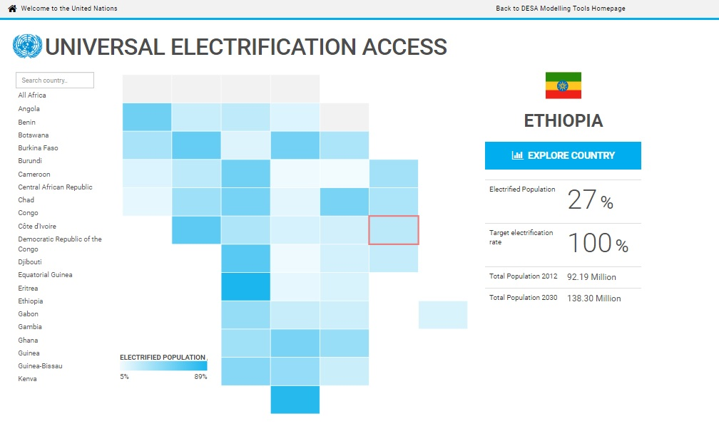
The online electrification interface
Overview of the country’s current electricity access rate
Overview of the estimated population by 2030
Notes:
Now we can get an overview of the country’s current electricity access rate, as well as its current and estimated population by 2030.

Slide 32

The online electrification interface
Select a representative cost for the grid
Shares of population with new access by technology
+
Select low or high diesel price
+
Select between five electrification access tiers (kWh/HH/year)
=
30 different electrification scenarios
Total investment requirements for the selected electrification tier in order to achieve 100 per cent access to electricity by 2030
Notes:
The analysis is carried out for several scenarios in order to capture the specificities of different countries.
Three different national grid electricity costs are considered. These depend on the electricity generation mix of each country.
Further, we consider two scenarios related to diesel prices (the current and projected ones). With this, we can evaluate how different diesel prices influence the technology choice.
Lastly, five electrification access tiers are taken into account. Each tier represents different levels of electricity services starting from basic lighting (lowest tier) to services that provide comfort, such as air-conditioning. In total, we have 30 scenarios. On the left side, we select scenarios. Let’s select…..
Results are shown in the map, table and graph. The optimal electrification split is presented in the map. The new connections appear here (show with the pointer). The share of each technology in terms of new connections is shown in this table, while the investment requirements for the selected electrification tier to reach universal access to electricity are presented in this graph (show with the pointer).

Slide 33
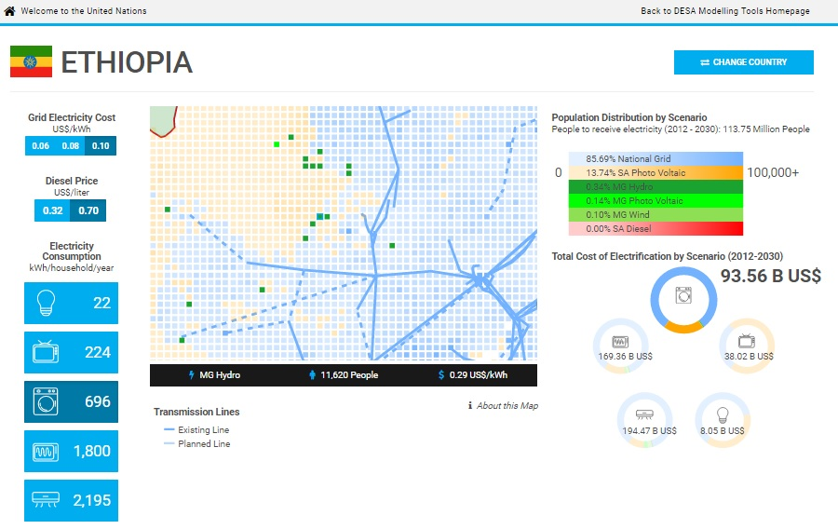
The online electrification interface
Available results per cell
Expected population in 2030
Most economic electrification option (grid, mini-grid or standalone)
LCOE generation achieved by this option
100 sq. km
2
1
3
Notes:
Note that the resolution of this analysis is 10x10 kilometres, i.e., the area of each grid cell is approximately 100 km². For each grid cell, we can read three critical figures. What is the expected population based on projections and GIS analysis?
What is the least-cost electrification technology, and what is the levelized cost of generating electricity achieved by this option?
All of these figures are available for roughly 240,000 locations on the continent.

Slide 34
Final remarks and takeaway messages
The electrification tool:
Is a complementary approach to already existing energy planning models that do not consider geospatial characteristics
Can be used to inform decision-making in the energy field (science-policy, financing, etc.)
At subnational level
At national level
At regional level
Can help analysts and planners identify $1.3 trilion worth of investment:
By country
By technology type
By location
Is an open and freely available source of information
Notes:
Some key takeaway messages regarding the electrification tool include:
This tool is a complementary approach to existing energy planning models that do not consider geographical characteristics related to energy.
It can be used to inform decision-making in the energy field, and to bridge science, technology and policy at different levels.
Moreover, it can help planners and analysts identify around $1.3 trillion in investments by country, location and technology type.
Lastly, one of most important aspects of this interface is its open-source nature. Anyone with access to the Internet may navigate through and download the results of the electrification analysis for 44 African countries.
ONSSET can already provide invaluable support to policy and decision-makers on least-cost electrification strategies. Most importantly, the tool specifically addresses the needs of the energy poor and offers solutions.
But is does not implement the identified strategies nor does it provide necessary finance. It highlights the challenges before policy and decision-makers charged with the implementation of SDG 7, and allows the analysis of trade-offs between competing demands on financial resources, and thus the prudent prioritization of available resources.

Slide 35
6. Hands-on experience with ONSSET

Slide 36
Uganda exercise
This training exercise has been developed in order to get the participants familiar with the electrification tool.
Group A
Team:
High-level decision makers
Policy managers
Task:
Writing policy notes for Uganda based on the online electrification results
Group B
Team:
Energy system modellers
Practitioners
Task:
Provide suggestions for electrification planning in Uganda using the online version of ONSSET
The two groups will have different tasks but the same goal:
Find the optimal pathways that will allow full electrification of Uganda by 2030.

Slide 37
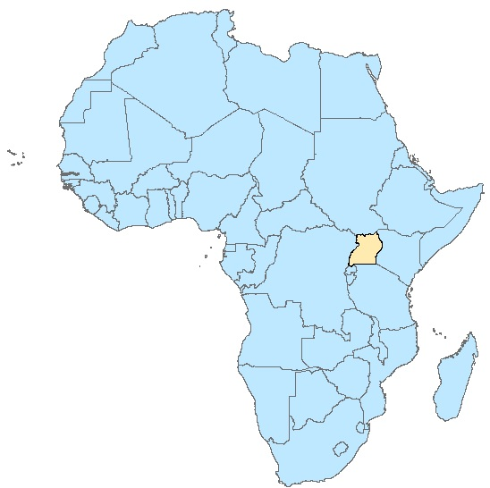

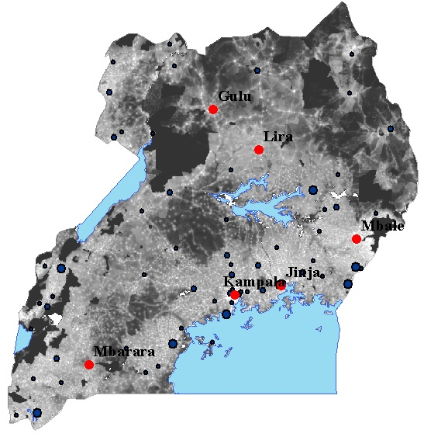
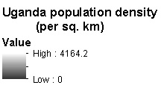
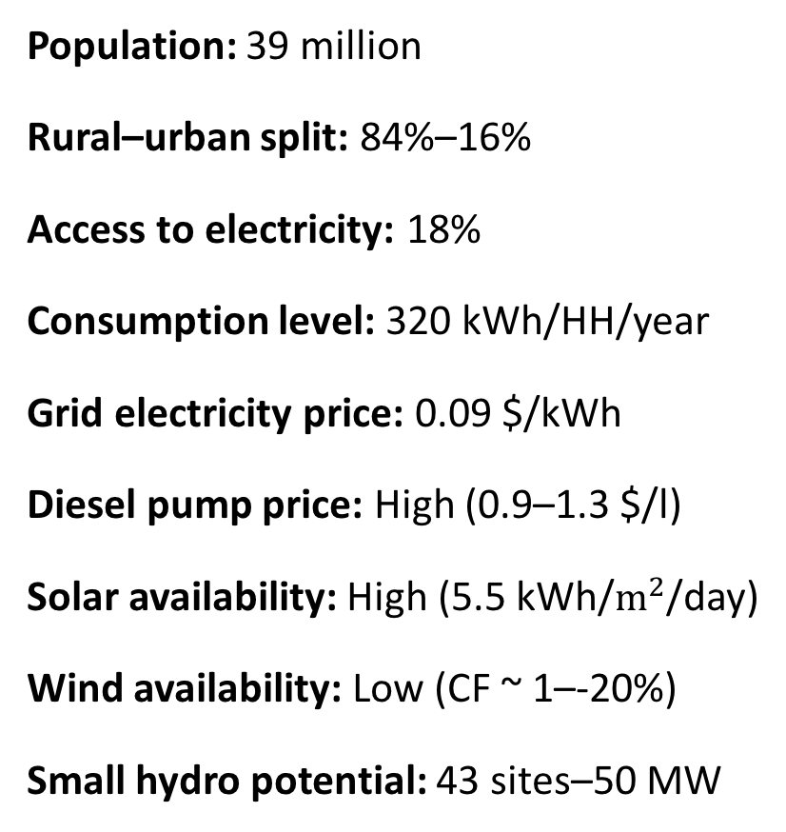
Uganda overview
Population: 39 million
Rural–urban split: 84%–16%
Access to electricity: 18%
Consumption level: 320 kWh/HH/year
Grid electricity price: 0.09 $/kWh
Diesel pump price: High (0.9–1.3 $/l)
Solar availability: High (5.5 kWh/$m^{2}$/day)
Wind availability: Low (CF ~ 1–-20%)
Small hydro potential: 43 sites–50 MW

Slide 38
Group A
Writing energy policy notes for Uganda based on the online electrification results
Task 1. Describe in bullet points 5 to 10 of the most important challenges that hinder full energy access in the country.
Task 2. Explain what the energy system (demand and supply) of the country will most probably look like in 15 years (e.g., 2030). What is the percentage of access to electricity expected to be? What resources are expected to be exploited in order to achieve full access to electricity?
Task 3. Simulate this scenario with reference to https://unite.un.org/sites/unite.un.org/files/app-desa-electrification/index.html.x.html
Task 4. Identify the optimal electrification option per region as well as the total investment requirements for full access to electricity. Do the solutions reflect the country’s vision? Is the country able to afford this transition? If not, what about reconsidering the scenario parameters?
Task 5. Design an electrification strategy per region. Where should the transmission network be expanded? Which areas are more favourable to mini-grids and which to standalone systems? Which resources are primarily utilized? What is the penetration of renewables in the electrification mix? How is that penetration affected by diesel price fluctuations?
Task 6. Write policy notes to facilitate the implementation of the electrification strategy. Introduce subsidies to the deployment of certain technologies, etc.

Slide 39
Group B
Provide suggestions for electrification planning based on the online version of ONSSET.
Task 1. Read “The case study of Uganda – Country review”, and determine and list the data requirements to build the model.
Task 2. Start data collection. Use free online sources to acquire what is needed.
Task 3. Use the simplified “online version of ONSSET” in order to insert the findings into the model.
Task 4. Identify the optimal (least cost) electrification option for Uganda for different scenarios, varying a number of factors such as electrification tier and diesel price.
Task 5. Based on the results, write notes that will support higher-level policy managers in developing electrification strategies. Do the solutions reflect the country’s vision for electrification?

Slide 40
Hands-on experience with the online ONSSET tool
ONSSET - The OpeN-Source Spatial Electrification Tool

Slide 41
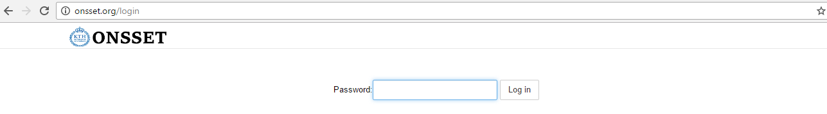
Welcome to ONSSET.org
Login password: newyork2016
This page contains the full code for the OpeN-Source Spatial Electrification Tool. The designed modules will guide you through the code as well as the various parameters that can be set to explore any scenario of interest. The code is split into blocks, and each one has a preceding block of text to explain its function.

Slide 42
ONSSET in six steps

Slide 43
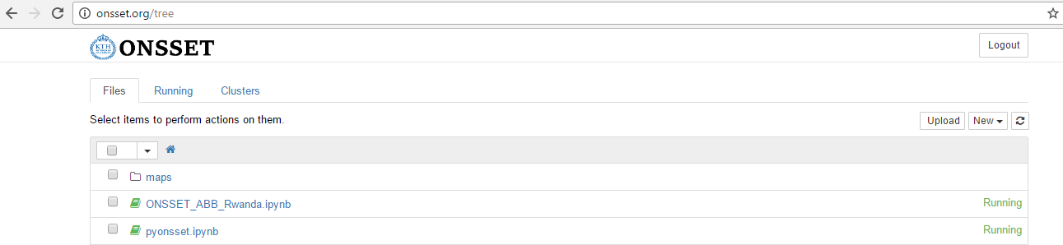
Step 1. Acquire the necessary GIS data for the area of interest.¹
Step 2. Use python techniques to extract useful information.²
A GIS environment (ArcGIS, QGIS, GRASS) is required.
Due to the complexity involved in GIS processing and time limitations of this lab session, a csv file with all the necessary GIS information has already been prepared by KTH dESA for the 10 selected countries.
The csv file for the selected country can be uploaded here.
1) A list of available datasets and potential sources.
2) A sample GIS to CSV extraction code is available.here.

Slide 44
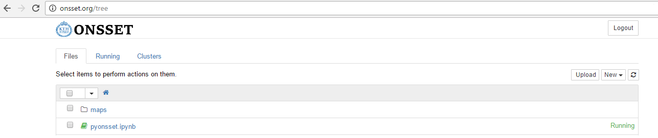

Pyonsset is the python module behind the ONSSET tool.
The runner button runs each block of code at a time.
The mode circle defines the progress of a task. If full, the model is performing a task.
Run the model step by step and observe which function is active at any given time..

Slide 45
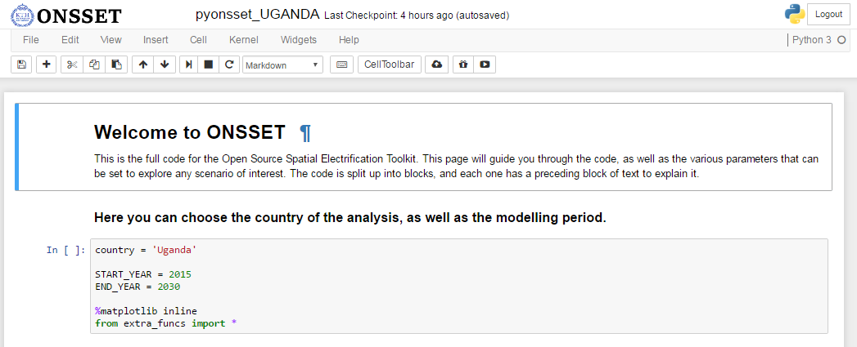
Country selection
Here the user can type in the country to be analysed.
Here the user can set the base year and the end year to be considered for the analysis.

Slide 46
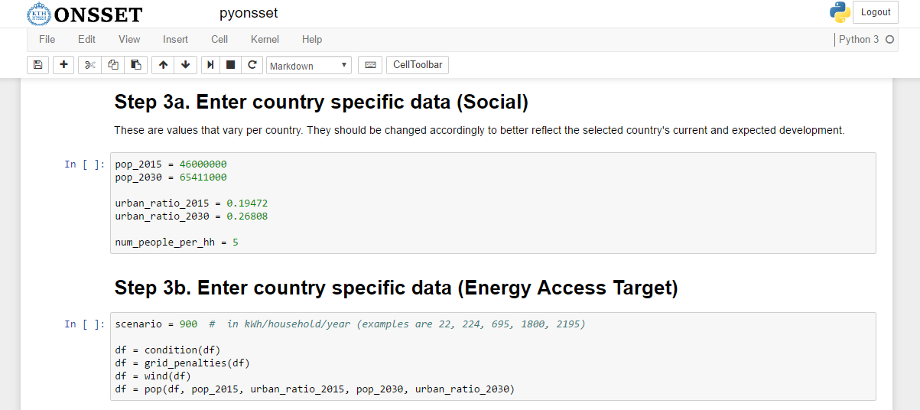
Step 3. Enter country-specific data
Here the user can insert population-based characteristics about the country of selection. Include values both for the base and end years of the analysis.
Potential sources
United Nations Population Division, 2015
The World Bank
Reports on Country socio-economic statistics
Here the user can insert the electricity access level to be achieved by every household within the defined timeframe.

Slide 47
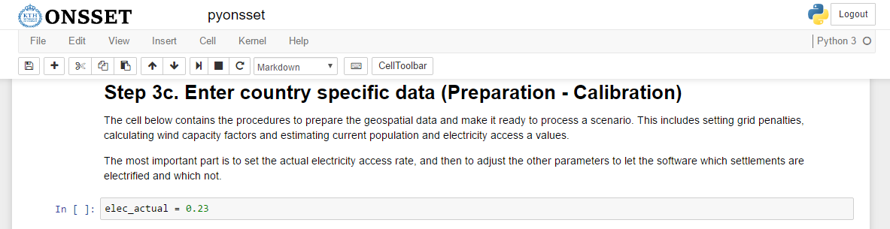
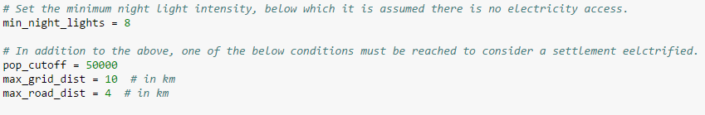
Step 3. Enter country-specific data
The user will have to insert manually four parameters:
Nighttime light intensity value (digital number)
Population level per settlement
Distance of the settlements from the electric grid
Distance of the settlements from the national road network
The user will then iterate accordingly so the model reaches the same electrification rate.
This is the country’s electrification rate in the base year.

Slide 48
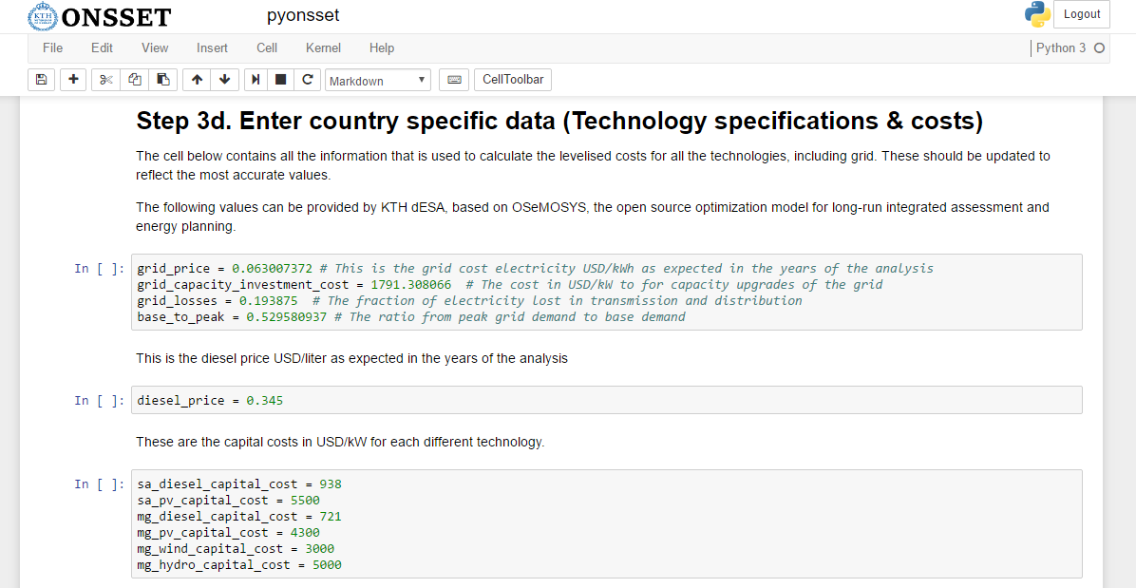
Step 3. Enter country-specific data
Here the user can insert pricing/costing information related to the national grid of the selected country. Grid_price refers to the cost at which the national grid is expected to be producing electricity over the modelling period.
This is the expected diesel price over the modelling period.
Here the user can insert capital costs for off-grid technologies.

Slide 49
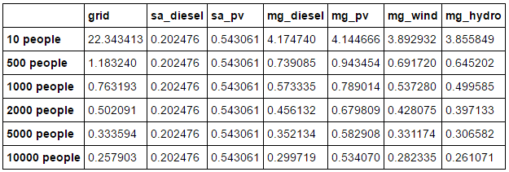
Step 4. Calculate the LCOE per technology for every settlement in the country
Here is an example of how the different technologies perform under certain assumptions:
- Distance from the national electricity grid: 20 km
- Global horizontal irradiation: 1500 kWh/m2/year
- Hydro availability: Positive
- Wind capacity factor: 40%
- Diesel price: 0.345 USD/liter
LCOE Tables
Example of LCOE variation per technology depending on number of people per settlement
Grid LCOE reduces in areas with high population density and proximity to the national grid.
Mini-grid LCOEs depend usually on resource availability and fuel costs.
Standalone system LCOEs change at a later stage according to transportation costs.

Slide 50
Step 5. The electrification algorithm – grid extension or off-grid?
?
50 km
?
Electrified
cells
1. Is the total additional medium-voltage line less than 50 kilometres?
2. Are there enough people (thus demand) to justify an extension of the grid?

Slide 51
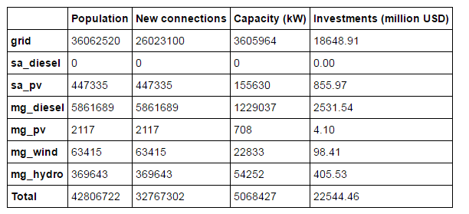
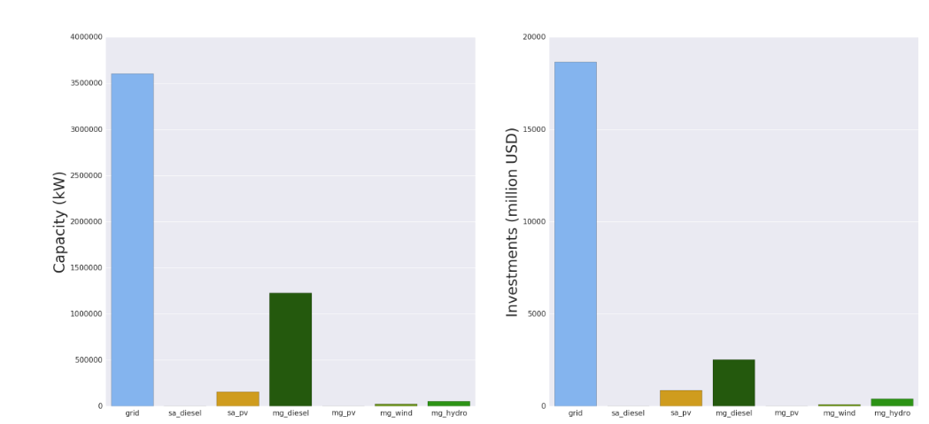
Step 6. Results, summaries and visualization
Based on the optimal split, identify per technology:
New connections by 2030
Additional capacity needed
Investment requirements

Slide 52
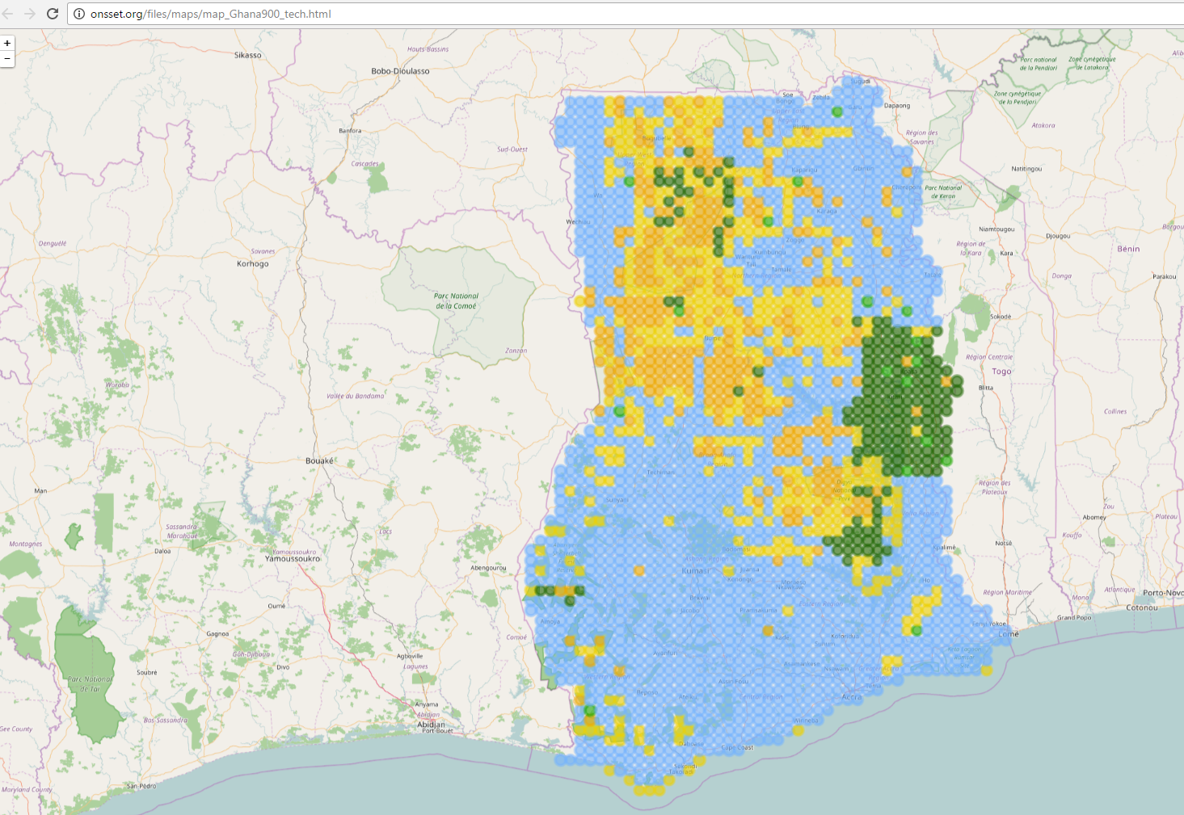
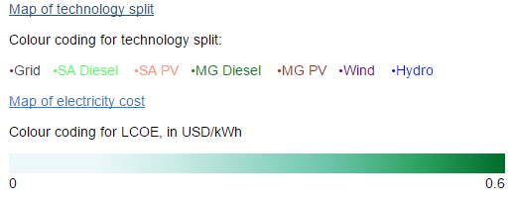

Slide 53
Discussion – Groups A and B
Compare findings, analyse and discuss potential differences, and collaboratively suggest improvements in the electrification planning process.
Group A
What are the most important hindrances to full electrification of Uganda?
What is the electrification strategy that Uganda should follow in order to achieve this goal by 2030?
What is the suggested energy policy that could facilitate the implementation of the electrification strategy?
Group B
What are the main electrification challenges in the country?
What is the optimal electrification option identified?
Is the policy proposed by Group A consistent with the findings here?
Find the optimal pathways that will allow full electrification of Uganda by 2030.

Slide 54
For further questions, please refer to
Dimitrios Mentis – dimitris.mentis@desa.kth.se
Mark Howells – mark.howells@energy.kth.se
Alexandros Korkovelos – alekor@desa.kth.se
Thank you

